Slide 1
Database Connectivity
Presented by: Prof. Cyrus Rj W. Robles

Slide 2
What is Database?
A database is essentially an organized collection of structured data. Think of it like a giant filing cabinet for information

Slide 3
Model Layer
The model layer in MVC is primarily responsible for representing the data and business logic of your application.
In the context of databases, the model layer often interacts with data access objects or repositories. These components handle the low-level details of fetching data from the database, translating it into model objects, and persisting changes back to the database.
The model typically doesn't have direct knowledge of the specific database technology (e.g., MySQL, Oracle) being used. It interacts with an abstraction layer that hides those implementation details.
Notes:
What is Database in MVC Design Pattern?

Slide 4
Controller Layer
The controller layer receives user requests and interacts with the model layer to retrieve or update data.
It doesn't directly access the database itself.
The controller relies on the model layer to handle database interactions through methods that expose the functionality you need.
Notes:
What is Database in MVC Design Pattern?

Slide 5
View Layer
The view layer is responsible for presenting data to the user.
It interacts with the model layer to get the data it needs to display.
The view layer has no direct connection to the database either.
Notes:
What is Database in MVC Design Pattern?

Slide 6
Concept of Data
Database
File Reading and Writing
Structured and organized data for efficient retrieval and manipulation.
Data integrity and consistency with clear rules enforced.
Concurrency control for multi-user access.
Scalability to handle large data volumes.
Robust security mechanisms.
A simple and quick way to store and access relatively small amounts of data.
Portability across different systems.
Performance benefits for specific use cases involving frequently accessed files.

Slide 7
Java Database Connectivity
Java Database Connectivity (JDBC) is a Java API for connecting and interacting with relational databases. It provides a standard interface for Java applications to access and manipulate data stored in databases using SQL (Structured Query Language). With JDBC, developers can establish connections to databases, execute SQL queries, retrieve and update data, and manage transactions, making it an essential tool for building database-driven applications in Java.

Slide 8
Set-up MySql Database

Slide 9
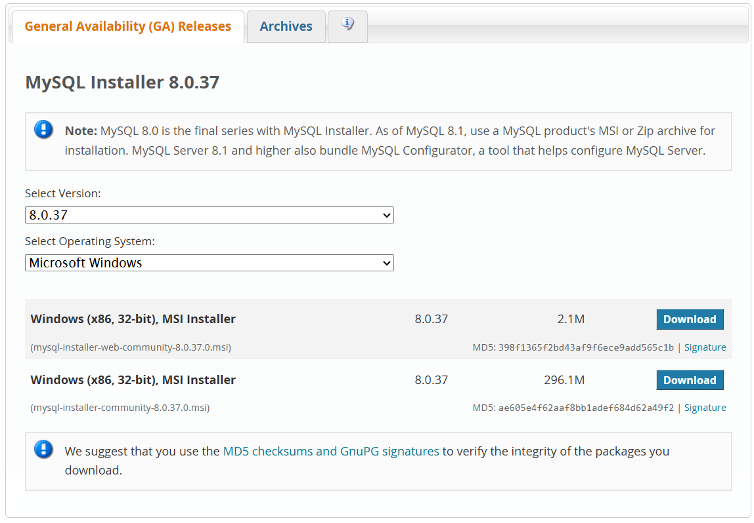
1st Step
https://dev.mysql.com/downloads/installer/

Slide 10
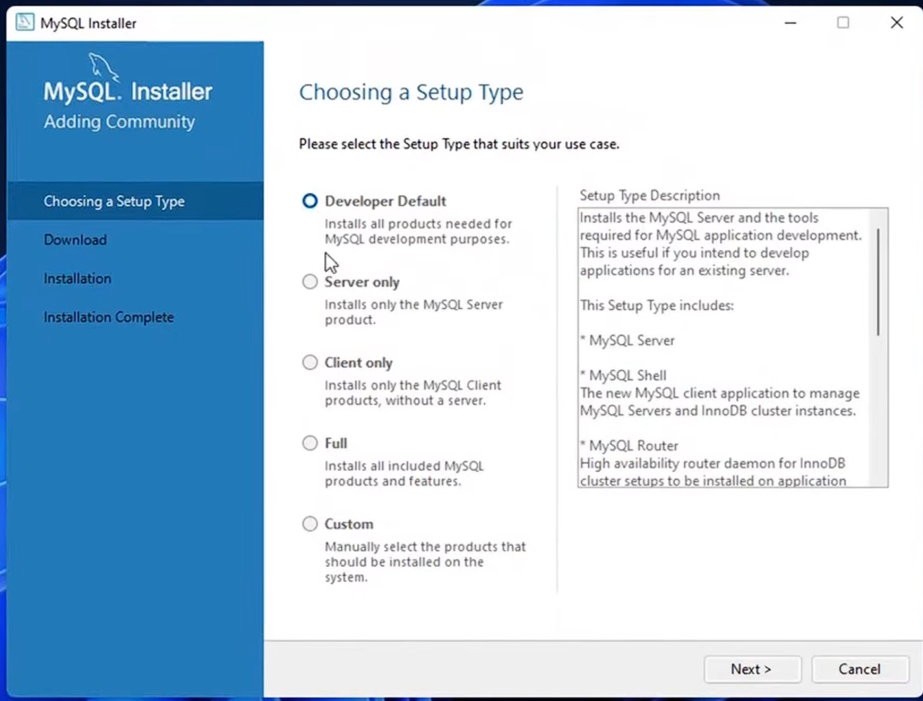
2nd Step
Choose Full

Slide 11
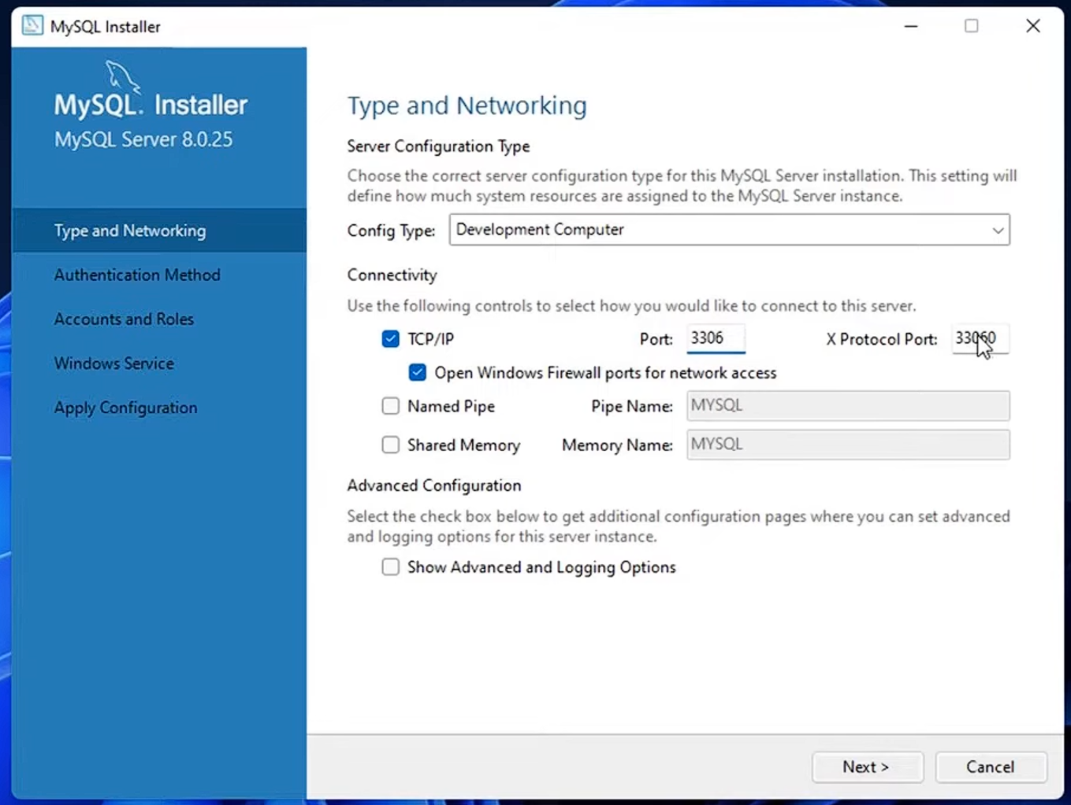
3rd Step
Default settings

Slide 12
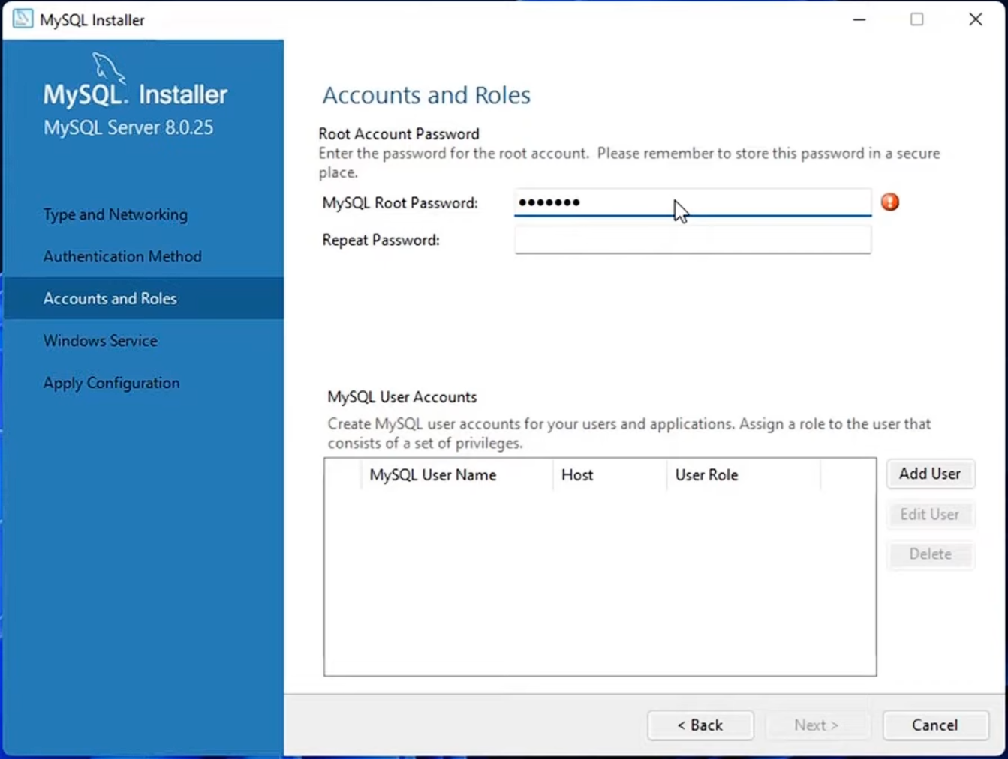
4th Step
Set-up the credentials

Slide 13
Set-up J/Connector

Slide 14
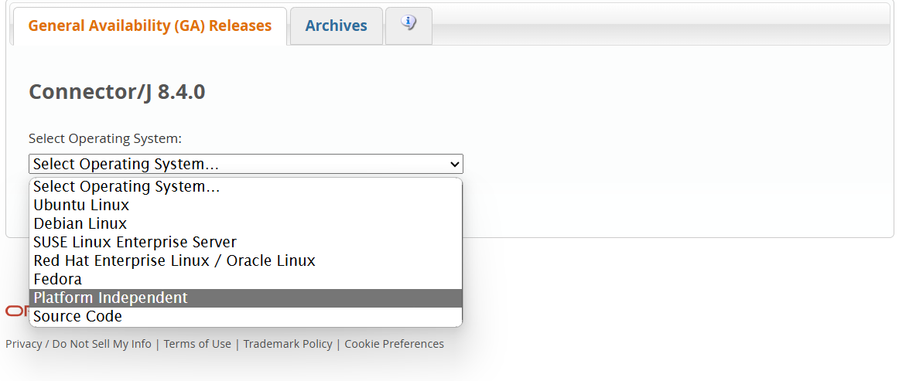
1st Step
GOTO: https://dev.mysql.com/downloads/connector/j/
and choose Platform Independent

Slide 15
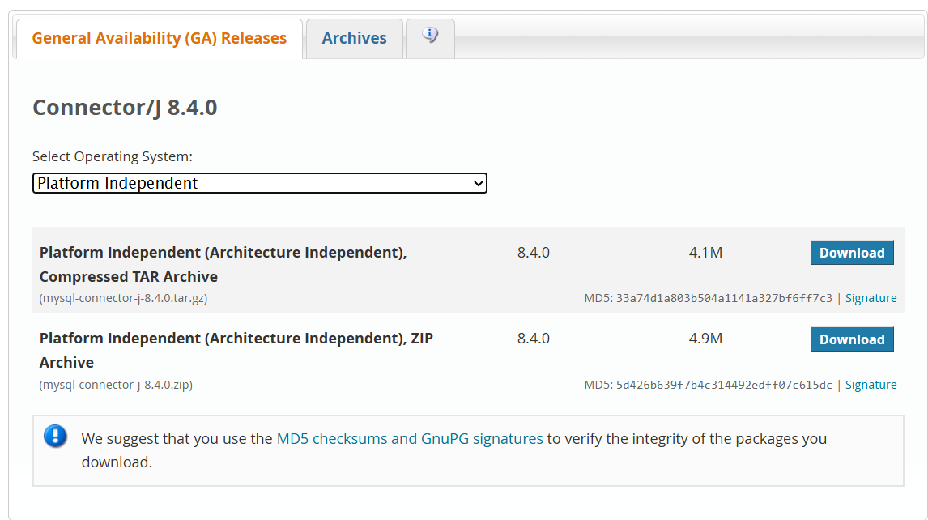
2nd Step
Select .zip file format and extract it.
NOTE: Find the .jar file and add it to the Java Project Libraries.

Slide 16
Java Database Connectivity

Slide 17
Connectivity Source Code
public class DatabaseConnection {
public static void main(String[] args) {
String url = "jdbc:mysql://localhost:3306/mydatabase"; // JDBC URL for the MySQL database
String user = "username"; // Replace with your database username
String password = "password"; // Replace with your database password
initDB(url, user, password);
}
}
public void initDB(String url, String user, String password){
try {
// Establish connection
Connection connection = DriverManager.getConnection(url, user, password);
System.out.println("Connected to the database!");
// Perform database operations (e.g., execute queries, update records, etc.)
// Close connection
connection.close();
System.out.println("Connection closed.");
} catch (SQLException e) {
e.printStackTrace();
}
}

Slide 18
Activity

Slide 19
References
https://www.w3schools.com/mysql/mysql_install_windows.asp
https://www.w3schools.in/mysql/setup/
https://dev.mysql.com/downloads/installer/
https://dev.mysql.com/doc/mysql-getting-started/en/
https://www.javaguides.net/2019/07/java-swing-jdbc-mysql-example.html

Slide 20
Thank youuu!!

